Slide 1
Lecture 4.2 - Unsupervised Learning

Slide 2

The GPU Teaching Kit is licensed by NVIDIA and New York University under the
Creative Commons Attribution-NonCommercial 4.0 International License.
Deck credit: Y. LeCun, Facebook

Slide 3
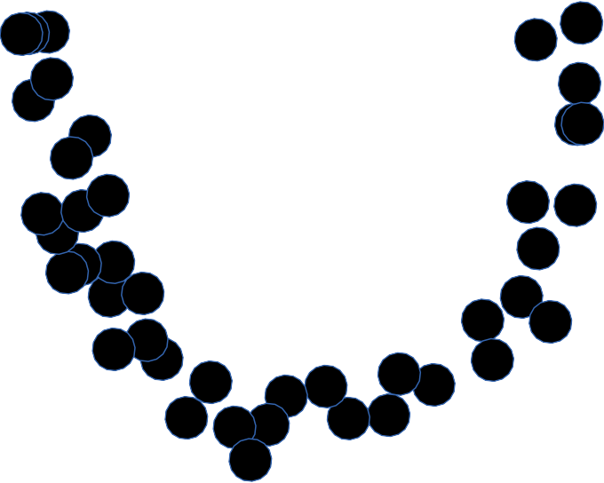
Energy-based unsupervised learning
Y LeCun
Learning an energy function (or contrast function) that takes
Low values on the data manifold
Higher values everywhere else
Y2
Y1

Slide 4
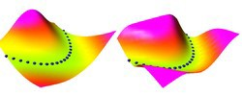
Capturing dependencies between variables with an energy function
Y LeCun
The energy surface is a “contrast function” that takes low values on the data manifold, and higher values everywhere else
Special case: energy = negative log density
Example: the samples live in the manifold
Y ₂=(Y ₁ )
2
Y1
Y2

Slide 5
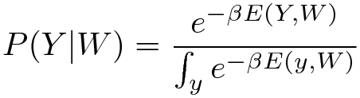
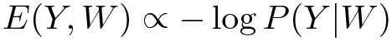
Transforming energies into probabilities (if necessary)
Y LeCun
The energy can be interpreted as an unnormalized negative log density
Gibbs distribution: Probability proportional to exp(-energy)
Beta parameter is akin to an inverse temperature
Don't compute probabilities unless you absolutely have to
Because the denominator is often intractable
P(Y|W)
Y
E(Y,W)
Y

Slide 6
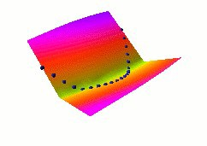
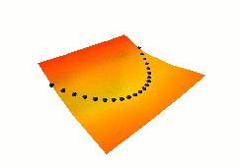
Learning the energy function
Y LeCun
Parameterized energy function E(Y,W)
Make the energy low on the samples
Make the energy higher everywhere else
Making the energy low on the samples is easy
But how do we make it higher everywhere else?

Slide 7
Seven strategies to shape the energy function
Y LeCun
Build the machine so that the volume of low energy stuff is constant
PCA, K-means, GMM, square ICA
Push down of the energy of data points, push up everywhere else
Max likelihood (needs tractable partition function)
Push down of the energy of data points, push up on chosen locations
contrastive divergence, Ratio Matching, Noise Contrastive Estimation, Minimum Probability Flow
Minimize the gradient and maximize the curvature around data points
score matching
Train a dynamical system so that the dynamics goes to the manifold
denoising auto-encoder
Use a regularizer that limits the volume of space that has low energy
Sparse coding, sparse auto-encoder, PSD
If E(Y) = ||Y - G(Y)||^2, make G(Y) as "constant" as possible.
Contracting auto-encoder, saturating auto-encoder

Slide 8

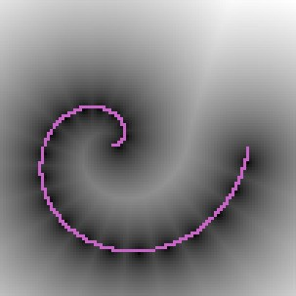
#1: Constant volume of low energy
Energy surface for PCA and K-means
Y LeCun
Build the machine so that the volume of low energy stuff is constant
PCA, K-means, GMM, square ICA...
K-Means,
Z constrained to 1-of-K code
2
PCA
E (Y )=∥W ^{T} WY −Y ∥²
E (Y )=min
∑
∥Y −W Z_{i}∥
z
i
i

Slide 9
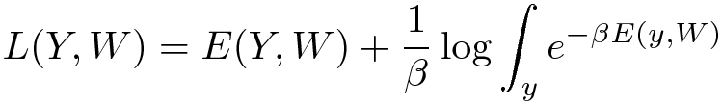
#2: Push down of the energy of data points, push up everywhere else
Max likelihood (requires a tractable partition function)
Maximizing P(Y|W) on training samples
Minimizing -log P(Y,W) on training samples
P(Y)
make this big
make this small
Y
E(Y)
make this small
make this big
Y

Slide 10
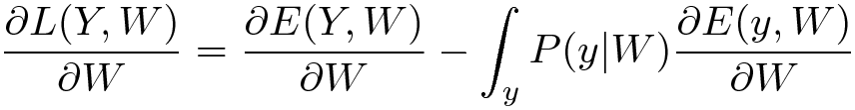
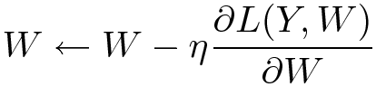
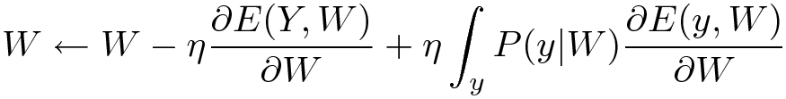
#2: Push down of the energy of data points, push up everywhere else
Gradient of the negative log-likelihood loss for one sample Y:
Gradient descent:
E(Y)
Pushes down on the energy of the samples
Pulls up on the
Y
energy of low-energy Y's

Slide 11
#3. Push down of the energy of data points, push up on chosen locations
Y LeCun
Contrastive divergence, Ratio Matching, Noise Contrastive Estimation, Minimum Probability Flow
Contrastive divergence: basic idea
Pick a training sample, lower the energy at that point
From the sample, move down in the energy surface with noise
Stop after a while
Push up on the energy of the point where we stopped
This creates grooves in the energy surface around data manifolds
CD can be applied to any energy function (not just RBMs)
Persistent CD: use a bunch of “particles” and remember their positions
Make them roll down the energy surface with noise
Push up on the energy wherever they are
Faster than CD
RBM
∑
T
E (Y , Z )=−Z ^{T} WY
E (Y )=−log
e
Z WY
z

Slide 12
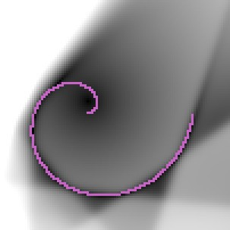
#6. Use a regularizer that limits the volume of space that has low energy
Sparse coding, sparse auto-encoder, Predictive Sparse Decomposition

Slide 13
Energy functions of various methods
2 dimensional toy dataset: spiral
Visualizing energy surface
(black = low, white = high)

Slide 14
Dictionary learning with fast approximate inference: sparse auto-encoders

Slide 15
How to speed up inference in a generative model?
Factor Graph with an asymmetric factor
Inference Z → Y is easy
Run Z through deterministic decoder, and sample Y
Inference Y → Z is hard, particularly if Decoder function is many-to-one
MAP: minimize sum of two factors with respect to Z
Z* = argmin_z Distance[Decoder(Z), Y] + FactorB(Z)
Examples: K-Means (1of K), Sparse Coding (sparse), Factor Analysis
Generative Model
Factor A
Distance
Decoder
Factor B
LATENT VARIABLE
INPUT
Y
Z

Slide 16
Sparse modeling: sparse coding + dictionary learning
Sparse linear reconstruction
Energy = reconstruction_error + code_prediction_error + code_sparsity
Inference is expensive: ISTA/FISTA, CGIHT, coordinate descent....
[Olshausen & Field 1997]
E (Y ^{i} , Z )=∥Y ^{i} −W
2
∑
Z∥ + λ
∣z ∣
d
j
j
W _{d} Z
DETERMINISTIC FUNCTION
λ∑_{j} .
∥Y ^{i} −Y ∥²
Y
FACTOR
Z
∣z _{j}∣
INPUT
FEATURES
FACTOR
Y → Ẑ =argmin _{Z} E (Y , Z )

Slide 17
#6. Use a regularizer that limits the volume of space that has low energy
Y LeCun
Sparse coding, sparse auto-encoder, Predictive Saprse Decomposition

Slide 18
Encoder-decoder architecture
[Kavukcuoglu, Ranzato, LeCun, rejected by every conference, 2008-2009]
Train a “simple” feed-forward function to predict the result of a complex optimization on the data points of interest
Find optimal Zi for all Yi; 2. Train Encoder to predict Zi from Yi
Generative Model
Factor A
Distance Decoder
Fast Feed-Forward Model
Factor B
LATENT VARIABLE
INPUT
Y
Z
Factor A'
Encoder Distance

Slide 19
Learning to perform approximate inference: predictive sparse decomposition sparse auto-encoders

Slide 20
Sparse auto-encoder: Predictive Sparse Decomposition (PSD)
[Kavukcuoglu, Ranzato, LeCun, 2008 → arXiv:1010.3467],
Prediction the optimal code with a trained encoder
Energy = reconstruction_error + code_prediction_error + code_sparsity
W _{d} Z
λ∑_{j} .
∥Y ^{i} −Y ∥²
Y
Z
∣z _{j}∣
INPUT
FEATURES
i
g_{e} (W_{e} ,Y)
∥Z −Z∥²

Slide 21
Regularized encoder-decoder model (auto-encoder) for unsupervised feature learning
Encoder: computes feature vector Z from input X
Decoder: reconstructs input X from feature vector Z
Feature vector: high dimensional and regularized (e.g. sparse)
Factor graph with energy function E(X,Z) with 3 terms:
Linear decoding function and reconstruction error
Non-Linear encoding function and prediction error term
Pooling function and regularization term (e.g. sparsity)
W _{d} Z
λ∑_{j} .
∥Y ^{i} −Y ∥²
INPUT
Y
Z
FEATURES
i
g_{e} (W_{e} ,Y)
∥Z −Z∥²
L2 norm within each pool

Slide 22
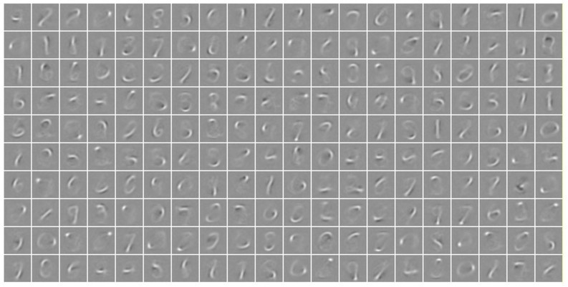
PSD: Basis functions on MNIST
Basis functions (and encoder matrix) are digit parts

Slide 23
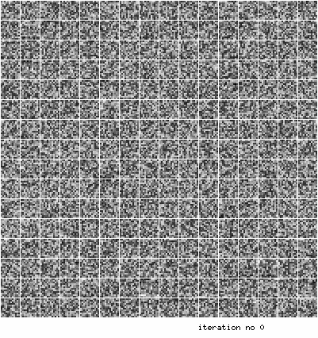
Predictive Sparse Decomposition (PSD): training
Training on natural images patches.
12X12
256 basis functions

Slide 24
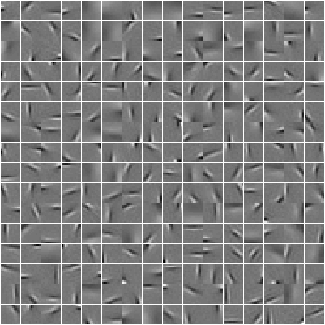
Learned features on natural patches: V1-like receptive fields
Y LeCun

Slide 25
Learning to perform approximate inference LISTA

Slide 26
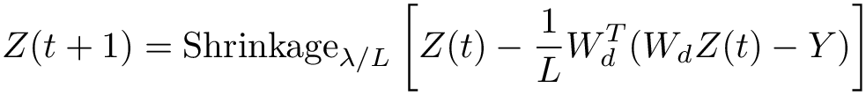
Better Idea: Give the “right” structure to the encoder
ISTA/FISTA: iterative algorithm that converges to optimal sparse code
ISTA/FISTA reparameterized:
LISTA (Learned ISTA): learn the We and S matrices to get fast solutions
[Gregor & LeCun, ICML 2010], [Bronstein et al. ICML 2012], [Rolfe & LeCun ICLR 2013]
W_{e}
+
sh()
INPUT
Y
Z
S
Lateral Inhibition

Slide 27
LISTA: Train We and S matrices to give a good approximation quickly
Think of the FISTA flow graph as a recurrent neural net where We and S are trainable parameters
Time-Unfold the flow graph for K iterations
Learn the We and S matrices with “backprop-through-time”
Get the best approximate solution within K iterations
W_{e}
+
sh()
INPUT
Y
Z
S
W_{e}
Y
+
sh()
S
+
sh()
S
Z

Slide 28
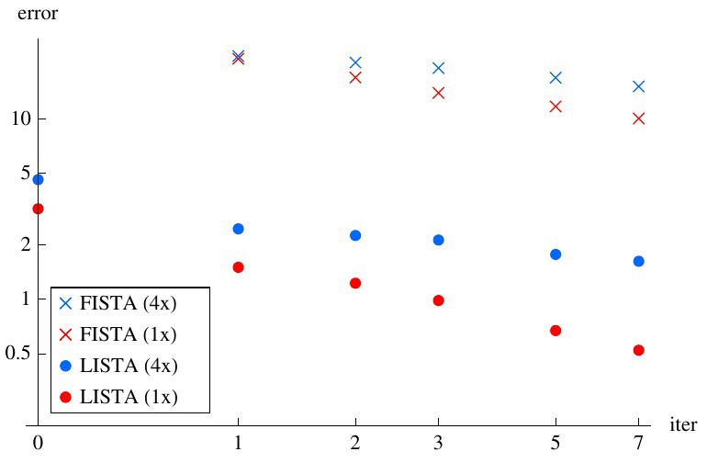
Learning ISTA (LISTA) vs ISTA/FISTA
Reconstruction Error
Number of LISTA or FISTA iterations

Slide 29
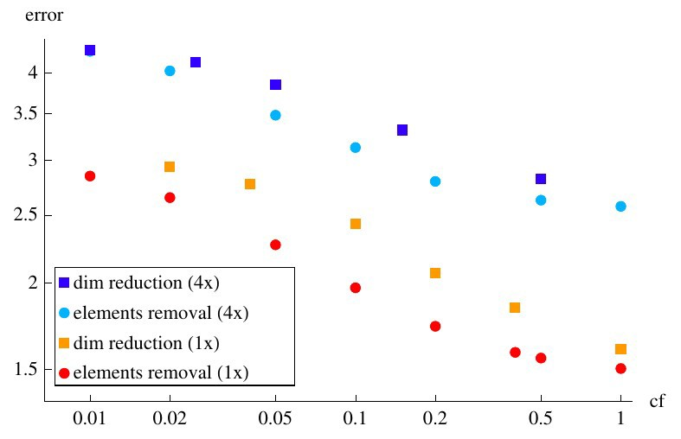
LISTA with partial mutual inhibition matrix
Reconstruction Error
Smallest elements removed
Proportion of S matrix elements that are non zero

Slide 30
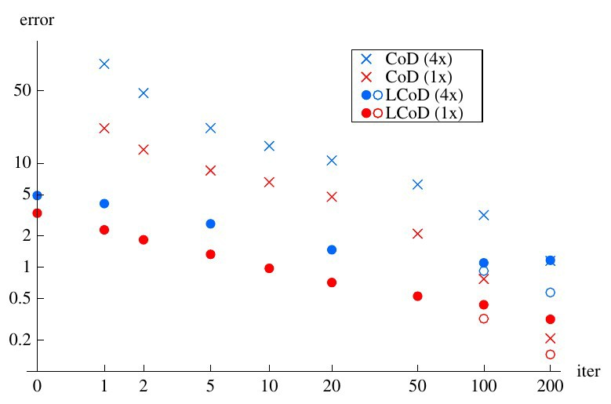
Learning Coordinate Descent (LcoD): faster than LISTA
Reconstruction Error
Number of LISTA or FISTA iterations

Slide 31
Discriminative Recurrent Sparse Auto-Encoder (DrSAE)
L₁
Z̄
0
Lateral
Decoding
Inhibition
Filters
X W_{e}
W_{d}
W_{c}
X̄
X
()⁺
S +
Can be repeated
()⁺
Encoding Filters
Ȳ
Y
Rectified linear units
Classification loss: cross-entropy
Reconstruction loss: squared error
Sparsity penalty: L1 norm of last hidden layer
Rows of Wd and columns of We constrained in unit sphere
[Rolfe & LeCun ICLR 2013]

Slide 32
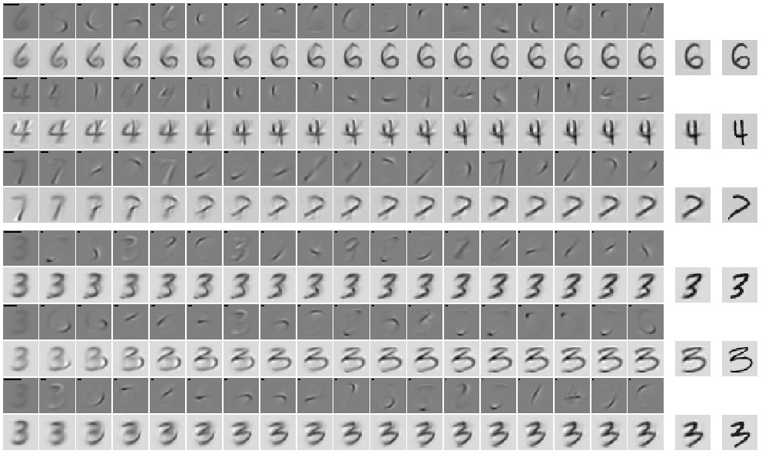
DrSAE Discovers manifold structure of handwritten digits
Image = prototype + sparse sum of “parts” (to move around the manifold)

Slide 33
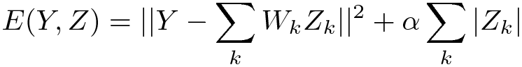
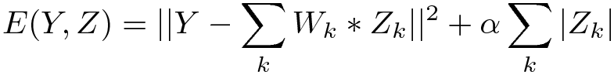
Convolutional sparse coding
Y LeCun
Replace the dot products with dictionary element by convolutions.
Input Y is a full image
Each code component Zk is a feature map (an image)
Each dictionary element is a convolution kernel
Regular sparse coding
Convolutional S.C.
Y
∑.
*
=
Zk
k
Wk
“deconvolutional networks” [Zeiler, Taylor, Fergus CVPR 2010]

Slide 34
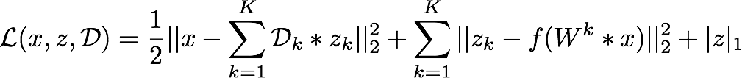
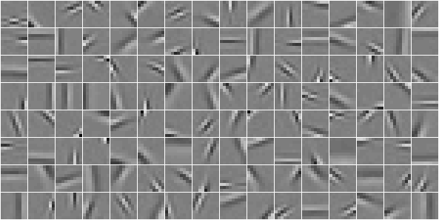
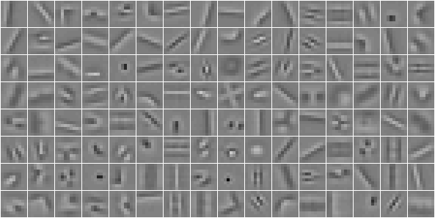
Convolutional PSD: Encoder with a soft sh() Function
Convolutional Formulation
Extend sparse coding from PATCH to IMAGE
PATCH based learning
CONVOLUTIONAL learning

Slide 35
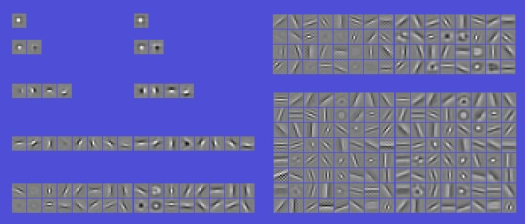
Convolutional sparse auto-encoder on natural images
Filters and Basis Functions obtained with 1, 2, 4, 8, 16, 32, and 64 filters.

Slide 36
Using PSD to train a hierarchy of features
Y LeCun
Phase 1: train first layer using PSD
W _{d} Z
λ ∑ .
∥Y ^{i} −Ỹ ∥²
Y
Z
∣z _{j}∣
i
g_{e} (W _{e} ,Y )
∥Z −Z̃ ∥²
FEATURES

Slide 37
Using PSD to train a hierarchy of features
Y LeCun
Phase 1: train first layer using PSD
Phase 2: use encoder + absolute value as feature extractor
Y
∣z _{j}∣
g_{e} (W _{e} ,Y^{i} )
FEATURES

Slide 38
Using PSD to train a hierarchy of features
Y LeCun
Phase 1: train first layer using PSD
Phase 2: use encoder + absolute value as feature extractor
Extractor Phase 3: train the second layer using PSD
λ ∑.
∥Y ^{i} −Ỹ ∥²
W _{d} Z
Y
∣z _{j}∣
Y
Z
∣z _{j}∣
g_{e} (W _{e} ,Y^{i} )
(
i
)
g W ,Y
∥Z −Z̃ ∥²
e
e
FEATURES

Slide 39
Using PSD to train a hierarchy of features
Y LeCun
Phase 1: train first layer using PSD
Phase 2: use encoder + absolute value as feature extractor
Extractor Phase 3: train the second layer using PSD
Phase 4: use encoder + absolute value as 2nd feature extractor
Y
∣z _{j}∣
∣z _{j}∣
g_{e} (W _{e} ,Y^{i} )
(
i
)
g W ,Y
e
FEATURES

Slide 40
Using PSD to train a hierarchy of features
Y LeCun
Phase 1: train first layer using PSD
Phase 2: use encoder + absolute value as feature extractor
Extractor Phase 3: train the second layer using PSD
Phase 4: use encoder + absolute value as 2nd feature extractor
Phase 5: train a supervised classifier on top
Phase 6: (optional): train the entire system with supervised back-propagation
Y
∣z _{j}∣
∣z _{j}∣
classifier
g_{e} (W _{e} ,Y^{i} )
(
i
)
g W ,Y
e
FEATURES

Slide 41
Unsupervised learning: Invariant features

Slide 42
Learning invariant features with L2 group sparsity
Unsupervised PSD ignores the spatial pooling step.
Could we devise a similar method that learns the pooling layer as well?
Idea [Hyvarinen & Hoyer 2001]: group sparsity on pools of features
Minimum number of pools must be non-zero
Number of features that are on within a pool doesn't matter
Pools tend to regroup similar features
W _{d} Z
λ∑ .
∥Y ^{i} − Ỹ ∥²
INPUT
Y
Z
FEATURES
g_{e} (W_{e} ,Y^{i})
∥Z −Z∥²
L2 norm within each pool

Slide 43
Learning invariant features with L2 group sparsity
Idea: features are pooled in group.
Sparsity: sum over groups of L2 norm of activity in group.
[Hyvärinen Hoyer 2001]: “subspace ICA”
decoder only, square
[Welling, Hinton, Osindero NIPS 2002]: pooled product of experts
encoder only, overcomplete, log student-T penalty on L2 pooling
[Kavukcuoglu, Ranzato, Fergus LeCun, CVPR 2010]: Invariant PSD
encoder-decoder (like PSD), overcomplete, L2 pooling
[Le et al. NIPS 2011]: Reconstruction ICA
Same as [Kavukcuoglu 2010] with linear encoder and tied decoder
[Gregor & LeCun arXiv:1006:0448, 2010] [Le et al. ICML 2012]
Locally-connect non shared (tiled) encoder-decoder
λ ∑ .
L2 norm within each pool
SIMPLE FEATURES
INPUT
Encoder only (PoE, ICA), Decoder Only or
Encoder-Decoder (iPSD, RICA)
√
(∑ )
Y
Z
Z
2
k
INVARIANT FEATURES

Slide 44
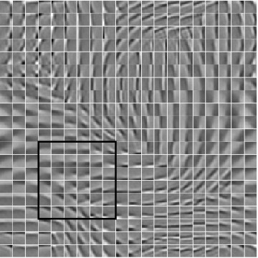
Groups are local in a 2D topographic map
Y LeCun
The filters arrange themselves spontaneously so that similar filters enter the same pool.
The pooling units can be seen as complex cells
Outputs of pooling units are invariant to local transformations of the input
For some it's translations, for others rotations, or other transformations.

Slide 45
Image-level training, local filters but no weight sharing
Y LeCun
Training on 115x115 images. Kernels are 15x15 (not shared across space!)
[Gregor & LeCun 2010]
Local receptive fields
No shared weights
4x overcomplete
L2 pooling
Group sparsity over pools

Slide 46
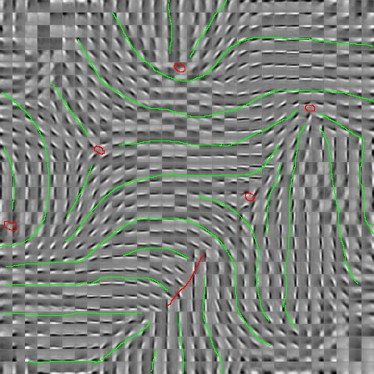
Image-level training, local filters but no weight sharing
Y LeCun
Training on 115x115 images. Kernels are 15x15 (not shared across space!)

Slide 47
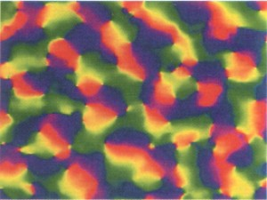
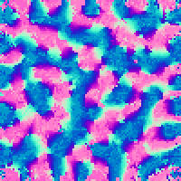
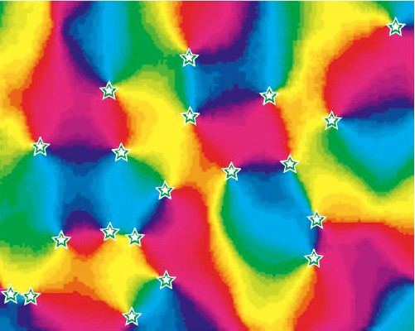
Topographic maps
K Obermayer and GG Blasdel, Journal of Neuroscience, Vol 13, 4114-4129 (Monkey)
Y LeCun
119x119 Image Input 100x100 Code
20x20 Receptive field size sigma=5
Michael C. Crair, et. al. The Journal of Neurophysiology Vol. 77 No. 6 June 1997, pp. 3381-3385 (Cat)

Slide 48
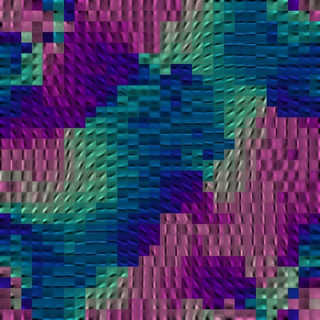
Image-level training, local filters but no weight sharing
Y LeCun
Color indicates orientation (by fitting Gabors)

Slide 49
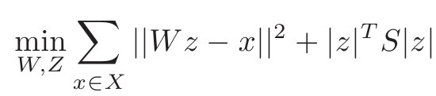
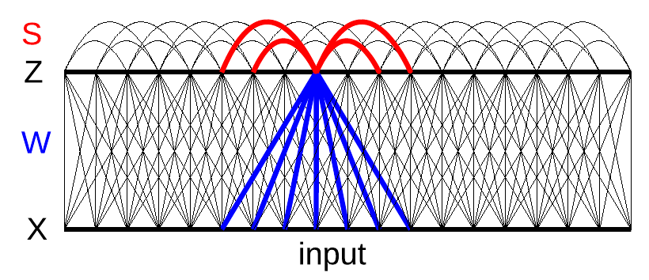
Invariant features lateral inhibition
Y LeCun
Replace the L1 sparsity term by a lateral inhibition matrix
Easy way to impose some structure on the sparsity
[Gregor, Szlam, LeCun NIPS 2011]

Slide 50
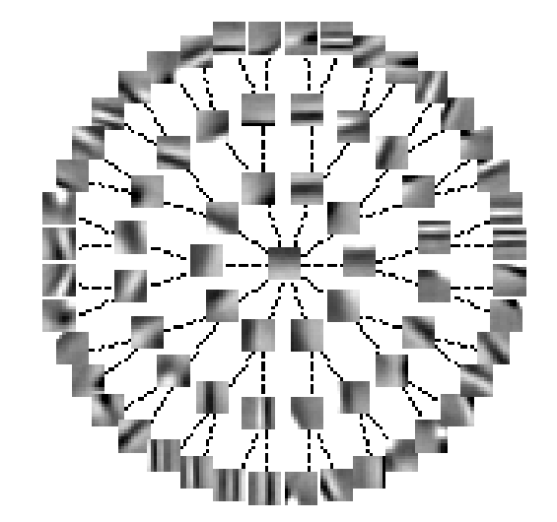
Invariant features via lateral inhibition: structured sparsity
Y LeCun
Each edge in the tree indicates a zero in the S matrix (no mutual inhibition)
Sij is larger if two neurons are far away in the tree

Slide 51
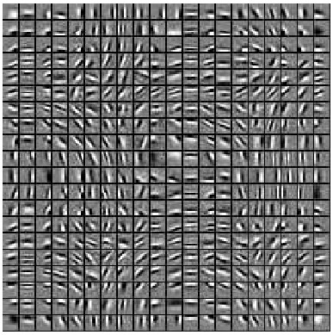
Invariant features via lateral inhibition: topographic maps
Y LeCun
Non-zero values in S form a ring in a 2D topology
Input patches are high-pass filtered

Slide 52
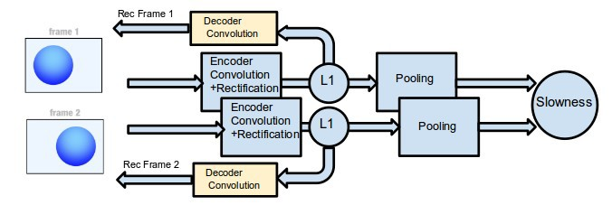
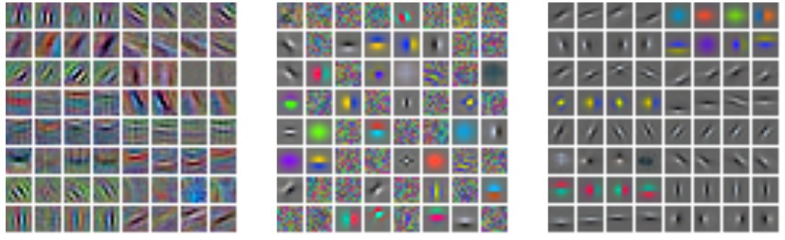
Sparse auto-encoder with “slow feature” penalty
Y LeCun
Supervised filters CIFAR10
sparse conv. auto-encoder
slow & sparse conv. auto-encoder Trained on YouTube videos
[Goroshin et al. Arxiv:1412.6056]

Slide 53
Invariant features through temporal constancy
Y LeCun
Object is cross-product of object type and instantiation parameters
Mapping units [Hinton 1981], capsules [Hinton 2011]
small medium
Object size
large
Object type
[Karol Gregor et al.]

Slide 54
what-where auto-encoder architecture
Y LeCun

Slide 55

Low-level filters connected to each complex cell
Y LeCun
C1
(where)
C2
(what)

Slide 56
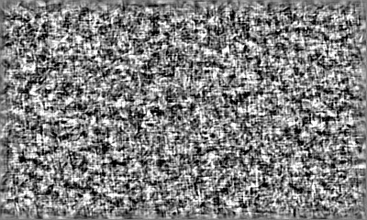
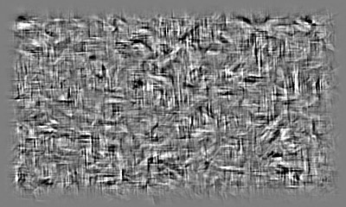
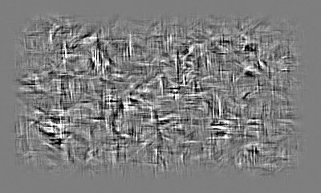
Generating images
Y LeCun
Generating images
Input

Slide 57
Thank you

